Slide 1


04/04/25
Layth Sattam
Verilog Logic Basics
Logic Diagram Builder
Online Verilog Compiler

Slide 2


Part 1:
Basic Logic Terms

Slide 3
Structure Declarations
module module_name(output_list, input_list);
Defines a self-contained block of logic.
output output_name1, output_name2, …;
Specifies a signal that carries the result.
input input_name1, input_name2, ...;
Specifies external signals that enter the module.
wire wire_name1, wire_name2, ...;
Defines temporary storage for intermediate logic results.
endmodule
Marks the end of the module.

Slide 4
Logic Components
not instance_name (out, in);
Outputs the inverse of the input (0 → 1, 1 → 0).
and instance_name (out, in1, in2);
Outputs 1 if all inputs are 1, else 0.
or instance_name (out, in1, in2);
Outputs 1 if at least one input is 1.
nand instance_name (out, in1, in2);
Outputs 0 only when all inputs are 1, otherwise 1.
nor instance_name (out, in1, in2);
Outputs 1 only when all inputs are 0.
xor instance_name (out, in1, in2);
Outputs 1 if only one input is 1.

Slide 5
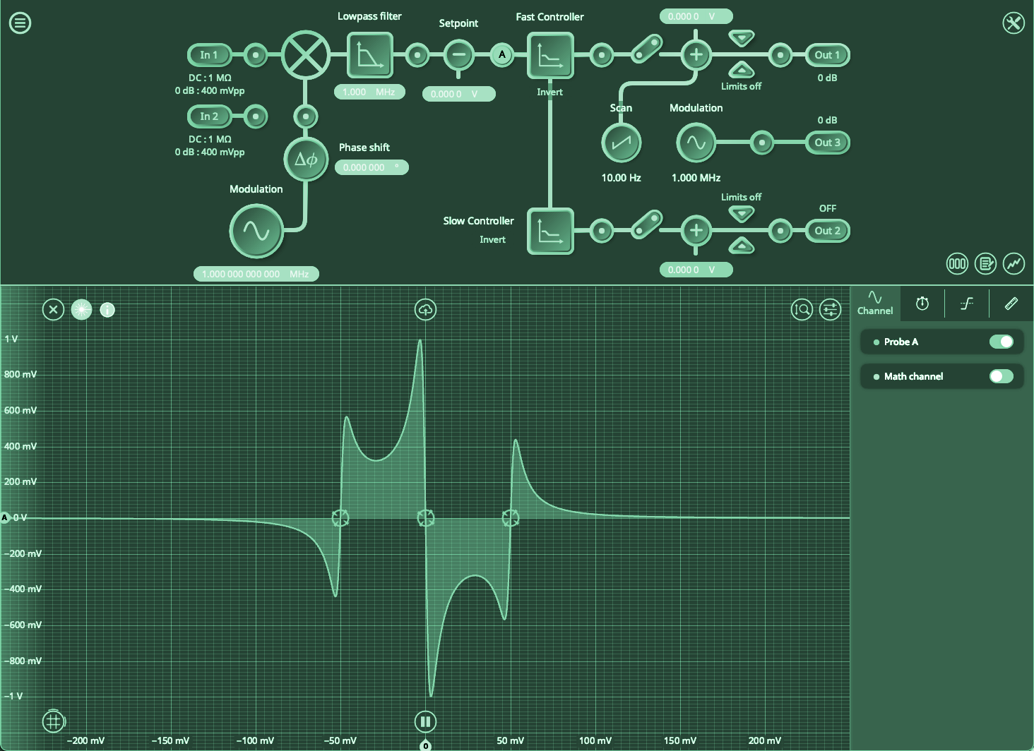

Part 2:
Basic Testbench Terms

Slide 6
Structure Declarations (TB)
`include "filename.v"
Imports external Verilog modules from another file.
module module_name();
Defines a testbench or logic block.
reg reg_name;
Stores input values for the logic (similar to variables).
wire wire_name;
Holds output signals from the logic module.
module_name instance_name (outputs, inputs);
Instantiates and connects the logic module.
endmodule
Marks the end of the module.

Slide 7
“Coding-like” Statements
begin .. end
Acts like C language curly brackets (“{}”)
initial begin ... end
Defines a block of code that runs once at the start.
for (integer init; condition; increment) begin ... end
Repeats a block of code while a condition is met.
Integer: shorthand for reg [31:0]
$display("format", values);
Prints values to the terminal for debugging.
'%b' - prints value in binary
'%d' - prints value in decimal
'%h' - prints value in hexadecimal

Slide 8
Logic Components (TB)
#time;
Simulates time progression in test cases.
{reg1, reg2} = value;
Assigns multiple registers from a single value.
{A, B, C} = X[x:y];
Vectorization: Groups multiple single-bit registers (reg or wire) into a multi-bit unit, allowing easy assignment.
The leftmost bit in {} is the most significant (MSB), while the rightmost is the least significant (LSB).

Slide 9
.Mem File Components
file_name.mem
.mem files store binary, decimal, or hex values for test cases. They act like a lookup table.
reg [width:0] name [size:0];
Creates a multi-row register. Used to make truth/look-up tables
$readmemb("path/to/file.mem", truthtable);
Reads a binary .mem file and loads it into a register array.

Slide 10



Part 3:
Basic Logic Model ＆ Testbench

Slide 11
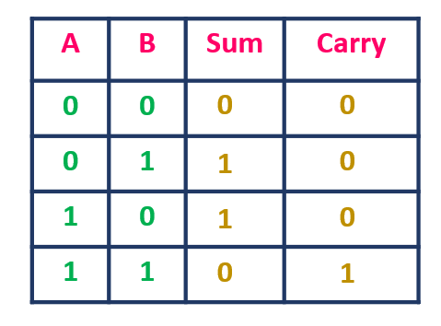
Half-Bit Adder
From the truth table, we observe that there are two outputs: Sum and Carry. This indicates that the circuit consists of two distinct yet self-contained logic components, while still following the same overall model.
The Sum (S) output follows the logic expression A’B + AB’, which corresponds to an XOR gate.
The Carry (C_{out}​ ) output follows the logic expression AB, which corresponds to an AND gate.

Slide 12
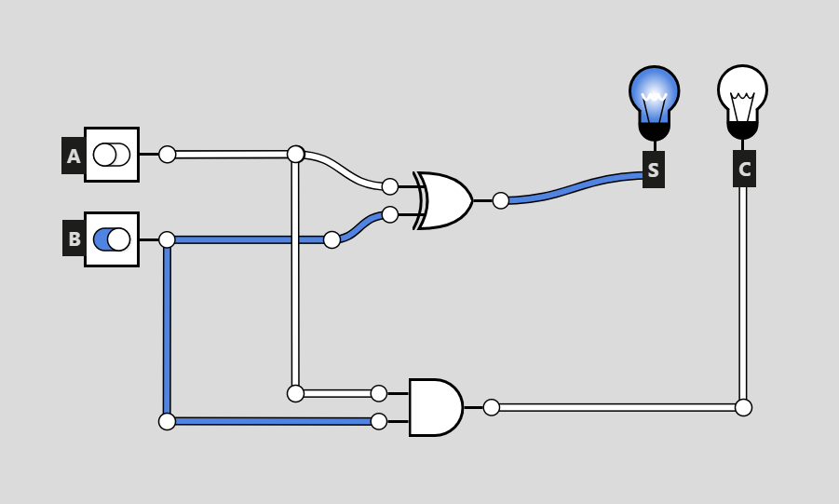
u0
u1

Slide 13
// Half-Bit Adder
module top(S, C, A, B); // By convention you should include your output ports
output S, C; // defines ports S and C as outputs
input A, B; // defines ports A and B as inputs
xor u0(S, A, B); // S = A ⊕ B
and u1(C, A, B); // C = AB
endmodule

Slide 14
`include "SampleLogicModels.v" // include our models
module testbench();
wire S, C; // outputs
reg A, B; // inputs
top UUT (S, C, A, B); // order does matter!!
initial begin
$display("A B | S C"); // prints to terminal
$display("----|----");
for (integer i = 0; i < 4; i++) begin // loop 4 times
{A, B} = i[1:0]; // Sets 'A' and 'B' to the two least significant bits of 'i'
#1; // one instance of time, 'locks in' values, preforms UUT logic
$display("%b %b | %b %b", A, B, S, C); // displays calculated truth table
end
end
endmodule

Slide 15
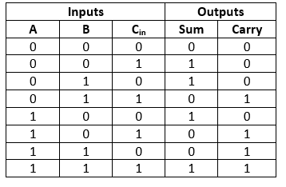
Full-Bit Adder
Full adders are more complex than half adders because they include an additional input, the carry-in (C_{in}), allowing them to account for carry-over from previous addition stages.
The Boolean expression for the Sum (S) output is:
S = A ⊕ B ⊕ C_{in​}
The Boolean expression for the Carry (C_{out}​ ) output is:
C_{out}​ = AB + C_{in​}​(A ⊕ B)

Slide 16
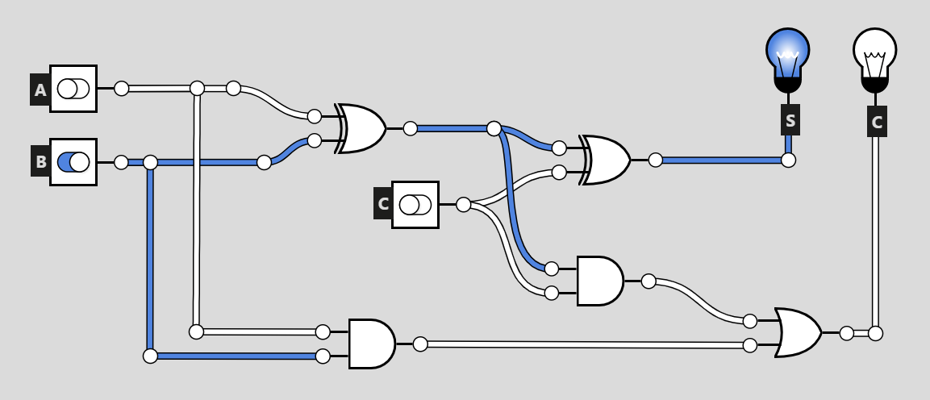
u0_0
w0_0
u1_0
u1_1
w1_1
u0_1
u2_0
w0_1

Slide 17
// Full-Bit Adder
module top(S, C_out, A, B, C_in); //C_out refers to the output, while C_in refers to the input
output S, C_out;
input A, B, C_in;
// Output S logic equation
wire w0_0;
xor u0_0(w0_0, A, B); // w0_0 = A ⊕ B
xor u1_0(S, w0_0, C_in); // C = w0_0 ⊕ C
// Output C_out logic equation
wire w0_1;
and u0_1(w0_1, A, B); // w0_1 = AB
wire w1_1;
and u1_1(w1_1, w0_0, C_in); // w1_1 = w0_0 * C_in
or u2_0(C_out, w1_1, w0_1); // C_out = w1_1 + w0_1
endmodule

Slide 18
`include "SampleLogicModels.v" // include our models
module testbench();
wire S, C_out; // outputs
reg A, B, C_in; // inputs
top UUT (S, C_out, A, B, C_in); // order does matter!!
initial begin
$display("A B C_in| S C_out"); // prints to terminal
$display("--------|--------");
for (integer i = 0; i < 8; i++) begin // loop 4 times
{A, B, C_in} = i[2:0];
// Sets 'A', 'B', and 'C' to the three least significant bits of 'i'
#1; // one instance of time, 'locks in' values, preforms UUT logic
$display("%b %b %b | %b %b", A, B, C_in, S, C_out);
// displays calculated truth table
end
end
endmodule

Slide 19
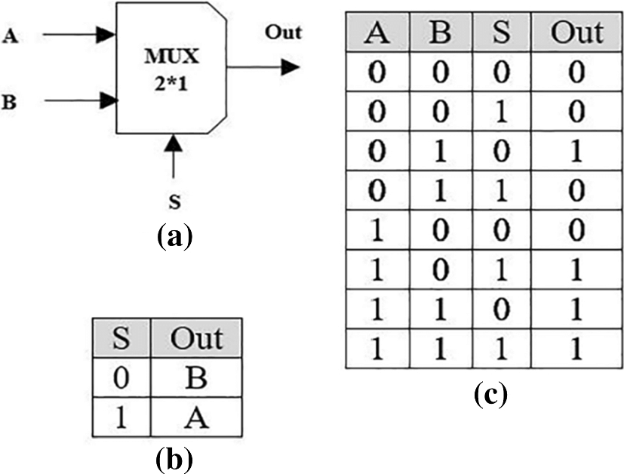
Multiplexer
Multiplexers (MUX) are logic circuits that select one of multiple inputs based on control signals and pass it to the output.
The Boolean expression for a 2-to-1 MUX is:
Y = AS’ + BS

Slide 20
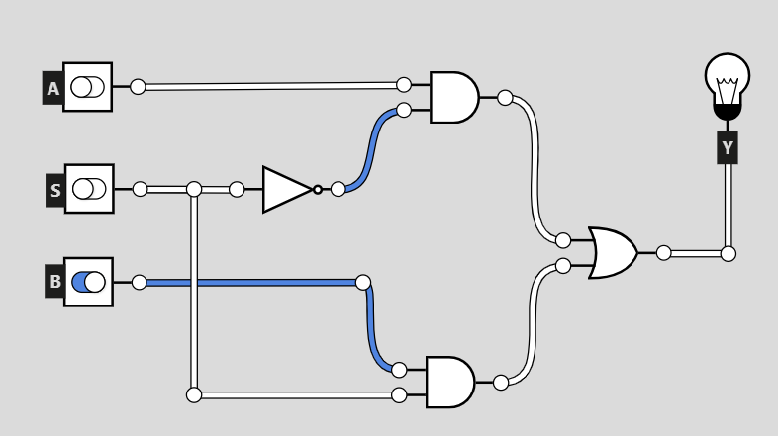
u0_0
w0_0
nS
nS
u1_0
u0_1
w0_1

Slide 21
// Multiplexer MUX 2-1
module top(Y, A, B, S);
output Y;
input A, B, S;
wire nS;
not u_nS(nS, S); // nS = S'
wire w0_0;
and u0_0(w0_0, A, nS); // w0_0 = A + nS
wire w0_1;
and u0_1(w0_1, B, S;) // w0_1 = B + S
or u1_0(Y, w0_0, w0_1); // Y = w0_0 + w0_1
endmodule

Slide 22
`include "SampleLogicModels.v" // include our models
module testbench(); // Multiplexer Mux 2-1 Testbench
wire Y; // outputs
reg S, A, B; // inputs
top UUT (Y, S, A, B); // order does matter!!
initial begin
$display("S A B | Y"); // prints to terminal
$display("------|--");
for (integer i = 0; i < 8; i++) begin // loop 4 times
{S, B, A} = i[2:0];
// Sets 'A', 'B', and 'S' to the three least significant bits of 'i'
#1; // one instance of time, 'locks in' values, preforms UUT logic
$display("%b %b %b | %b", S, A, B, Y); // displays calculated truth table
end
end
endmodule

Slide 23

.mem Files
From a memory file (.mem), we can load predefined values directly into simulation registers or arrays, streamlining the testing process for Verilog circuits.
Each line of the memory file represents a binary or hexadecimal value, corresponding to specific inputs and expected outputs. These are read using system tasks like $readmemb or $readmemh.

Slide 24
`include "SampleLogicModels.v" // include our models
module testbench(); // .mem File Example Testbench
wire F;
reg A, B, C;
top UUT(F, A, B, C);
reg [3:0] truthtable [15:0]; // 4-bit register, 16 rows
reg [2:0] passed; = 3'b0; // 3-bit register to indicate amount passed situation
// 3'b0 is shorthand for '000'
initial begin
$readmemb("C:\\Projects\\Verilog\\BasicMemLogic.mem", truthtable);
//$readmemb(path, regester), read values from .mem file into register
//$readmemd() for decimal and &readmemh for hexadecimal
for (integer i = 0; i < 16; i++) begin
{A, B, C} = truthtable[i][3:1]; // 'i' parses through each row of the table
// sets 'A', 'B', and 'C' to MSB of the table, LSB stores the expected outcome
#1;
if (F == truthtable[i][0]) passed++;
// if calculated F value is equal to the Expected outcome in the truth table(LSB), increment passed
else $display("Row %d failed: %b", i, truthtable[i]);
end
$display("%d out of 16 passed", passed);
end
endmodule

Slide 25




Q ＆A

